Slide 1

Problem Solving Using Computer
Course Code: BCAC 0018
Lecture – 13 & 14
Course: BCA I Year I Semester
By: Mr. Shivank Chauhan
shivank.chauhan@gla.ac.in
+91-9694159338

Slide 2
Algorithm
The step by step process to solve any logical and mathematical problem is called an algorithm.
An algorithm is a sequence of computational steps that transform input to desired output.
(Thomas H. Coreman)

Slide 3
Characteristics of Algorithm
All algorithms must satisfy the following five criteria:
Input
Output
Definiteness
Finiteness
Effectiveness

Slide 4
Characteristics of Algorithm
Input – It receives at least one input.
Output − It provides the desired output.
Definiteness − The Algorithm should be written in such a manner that its intent should be clear.
Finiteness – A good algorithm takes a finite number of steps before finishing.
Effectiveness – The Algorithm should be written in such a manner that it fulfill the purpose for that it is designed.

Slide 5
Flowchart
A flowchart is a diagrammatic representation of a problem-solving process in which steps are laid out in logical order.

Slide 6
Symbols Used in a Flowchart
  Oval (Start/Stop box): Used to indicate the start and end of the program.
  Rectangle (Process box): Indicates processes or actions.
  Parallelogram (Input / Output box): Indicates input and output of a program.
  Diamond (Decision box): Used in situation which demands one to choose either ‘Yes’ or ‘No’.
  Arrow line (Flow lines): Shows the flow of logic in a flowchart.

Slide 7
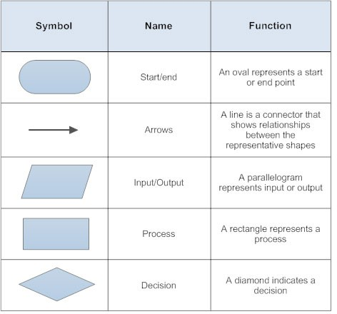

Slide 8
Rules to Design Flowchart
Following are the rules to design flowchart:
  A flowchart should have only one Start and one Stop symbol.
  The general direction of flow in a flowchart is from top to bottom or from left to right.
  Arrowheads are used to indicate the flow of information or sequence of steps.
  The arrow lines should not cross each other.

Slide 9
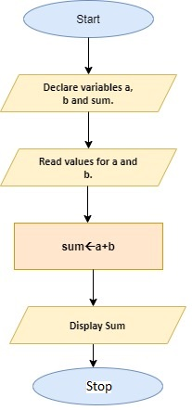
Algorithm Flow Chart
Step 1: Start
Step 2: Declare variables a, b and sum.
Step 3: Read values for a and b.
Step 4: Add a and b and assign the result to a variable sum.
Step 5: Display sum
Step 6: Stop

Slide 10
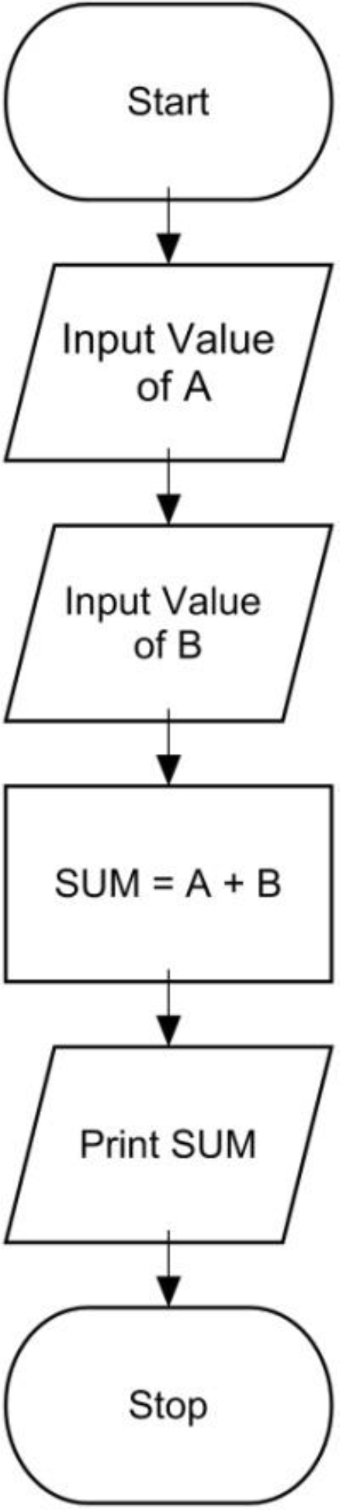
Algorithm & Flowchart to find the sum of two numbers
Algorithm
Step-1 Start
Step-2 Input first numbers say A
Step-3 Input second number say B
Step-4 SUM = A + B
Step-5 Display SUM
Step-6 Stop

Slide 11
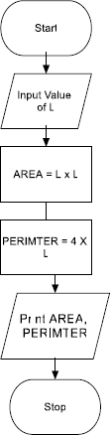
Algorithm & Flowchart to find Area and Perimeter of Square
Algorithm
Step-1 Start
Step-2 Input Side Length of Square say L
Step-3 Area = L x L
Step-4 PERIMETER = 4 x L
Step-5 Display AREA, PERIMETER
Step-6 Stop

Slide 12
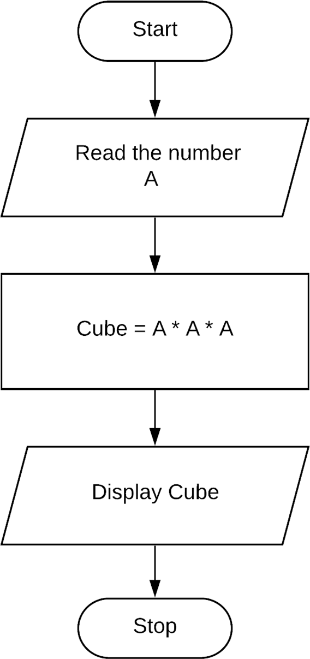
      Algorithm and Flowchart to Find the cube of a given number.
Algorithm
Step 1: Start
Step 2: Read the number and store it in a.
Step 3: Calculate cube of number as a * a * a
Step 4: Print cube of number
Step 5: Stop

